Slide 1
Comparative Study of Software Metrics :
An Epitome

Slide 2

Measure - quantitative indication of extent, amount, dimension, capacity, or size of some attribute of a product or process.
  E.g., Number of errors
Metric - quantitative measure of degree to which a system, component or process possesses a given attribute. “A handle or guess about a given attribute.”
  E.g., Number of errors found per person hours expended

Slide 3
“When you can measure what you are speaking about, and can express it in numbers, you know something about it; but when you cannot measure it, when you cannot express it in numbers.”- By Load Kelvin.
Software metrics deals with the measurement of the software product and the process by which it is developed.

Slide 4

Measurement
Based
Techniques
Applied
To
To
Supply
Software
Processes,
Products &
Services
Engineering &
Management
Information
To
Improve

Slide 5



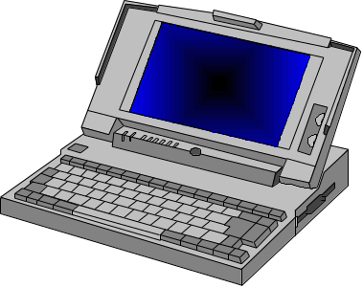
Entity:
Attribute:
Features & Properties
Mapping:
Numbers
&
Symbols

Slide 6

Determine the quality of the current product or process
Predict qualities of a product/process
Improve quality of a product/process

Slide 7

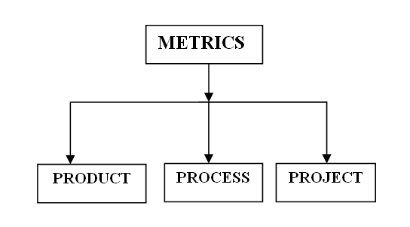

Slide 8

Measures the software product at any stage of its development, from requirements to installed system.

Slide 9
Size Metrics – it defines the line of code, number of modules, number of documentation pages, number of test cases etc.
Complexity Metrics – it defines the algorithmic complexity, data complexity, logical complexity, functional complexity, cyclomatic complexity etc.
Structure Metrics – it defines the composition level, decomposition level, coupling metrics, tree structure metrics and visualization level.
Quality Metrics – it defines the accuracy, security, interoperability, understand ability, efficiency metrics, usability metrics, maintainability metrics and portability metrics.

Slide 10

Measures the software development process such as time to produce the product, maturity of the process, type of methodology used

Slide 11
Maturity Metrics – it describes the personal structure metrics, management metrics, development team metrics, training metrics, productivity metrics, efficiency metrics, data management level metrics etc.
Management Metrics – it describes the risk metrics, work flow metrics, data analysis metrics, customer satisfaction metrics, review metrics, configuration management metrics etc.
Life Cycle Metrics – it describes the problem definition metrics, requirement analysis and specification metrics, design metrics, implementation metrics, maintenance metrics.

Slide 12

Measures the project characteristics and execution. It is also known as resource metrics.

Slide 13
Software Metrics – it defines the method productivity, performance metrics, replacement metrics and development environment trends.
Hardware Metrics – it defines the computer performance, network performance, security constraints, local availability and reliability metrics.
Personnel Metrics – it defines the programming experience metrics, communication level metrics, team work experience, hierarchy metrics and personal availability metrics.

Slide 14

understand
evaluate
control
predict
attribute
of the
entity
in order
to
To
the
goal(s)
Example - Metric: % defects corrected
% defects
found &
corrected
during
testing
ensure all
known defects
are corrected
before
shipment
evaluate
in order
to
To
the

Slide 15
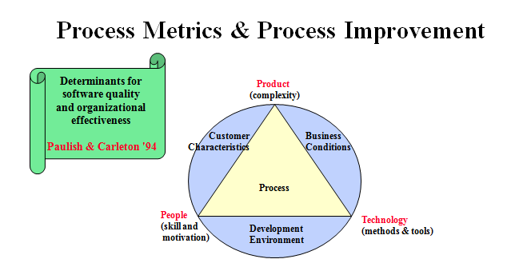

Slide 16

Understand
Control
Processes,
Products &
Services
Evaluate
Predict

Slide 17




Use metrics as a “stick”
Measure individuals
Use only one metric
Cost
Quality
Schedule
Ignore the data

Slide 18


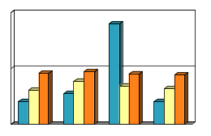


Select metrics based on goals
Provide feedback
Data
Goal 1
Goal 2
Question 1
Question 2
Question 3
Question 4
[Basili-88]
Data Providers
Metrics
Metrics 1
Metric 2
Metric 3
Metric 4
Metric 5
Feedback
Processes,
Products &
Services
Obtain “buy-in”
Focus on processes, products & services

Slide 19


